Slide 1
Support Vector Machines
Linear SVC
Kernel SVC
Regression

Slide 2
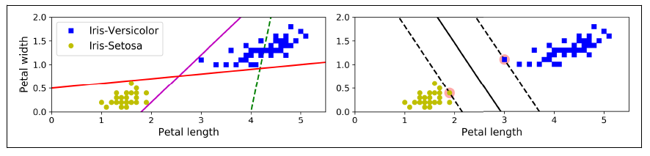
Linear SVM
Support Vectors
The two classes can clearly be separated easily with a straight line (they are linearly separable). These are also called as hyperplanes. But there are many such possible hyperplanes.
Compare the plot to the left and right. The solid line on the right not only separates the two classes but also stays as far away from the closest training instances as possible.
You can think of an SVM classifier as fitting the widest possible street (represented by the parallel dashed lines) between the classes.
This is called large margin classification or also maximum margin classification.
Adding more data outside of the street does not affect the separation line. It is only the points on the street edges that matter. These are called ‘support vectors’
This is also called Hard Margin classification because no points are allowed in the street.

Slide 3
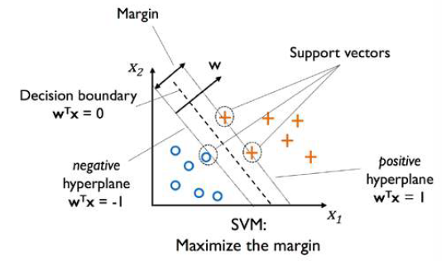



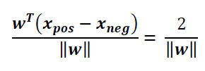

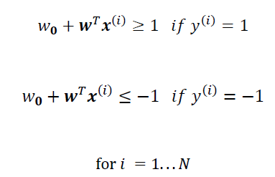

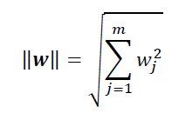

Linear SVM
Let the support vector of positive and negative classes be $x_{pos}$ and $x_{neg}$ respectively.
We can represent the edges as follows
Subtract the two and normalize
Maximizing margin $x_{pos}−x_{neg}$is same as minimizing $|\left|w\right||$ under the following constraints. This is solved using quadratic programming.
Minimize or

Slide 4
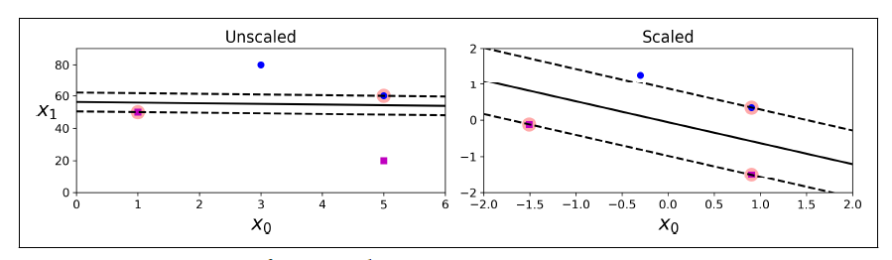
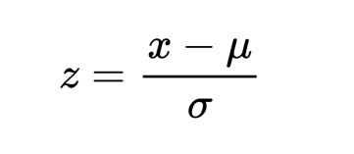
Scale Sensitivity
SVMs are highly sensitive to feature scales.
For best performance, scale the data so that all the features are in a similar range.
One way to do this is standardizing the data. We subtract each feature by their mean and divide by the standard deviation.

Slide 5
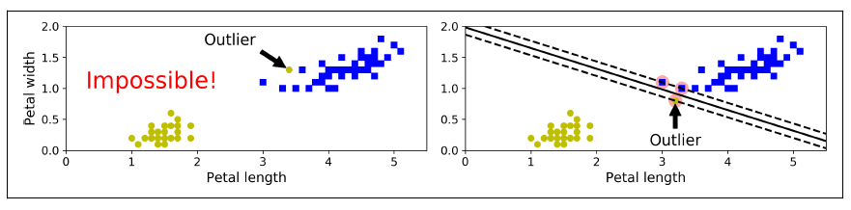



Soft Margin Linear SVM
What if there are outliers? There’s no way you can separate them linearly without violation.
We can have a balance between maximum margin and a few margin violations. This is called soft margin classification.
The objective remains the same. We just need to relax the constraints. We introduce slack variables.
This can be solved using gradient descent.

Slide 6
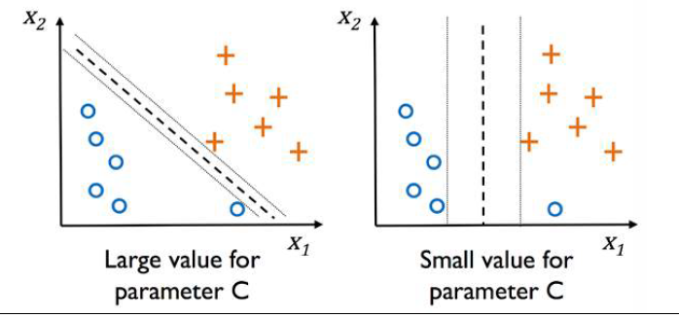
Soft Margin Linear SVM
We use C to control the size of the margin and the amount of margin violations.
Hence, C is a regularization parameter.

Slide 7
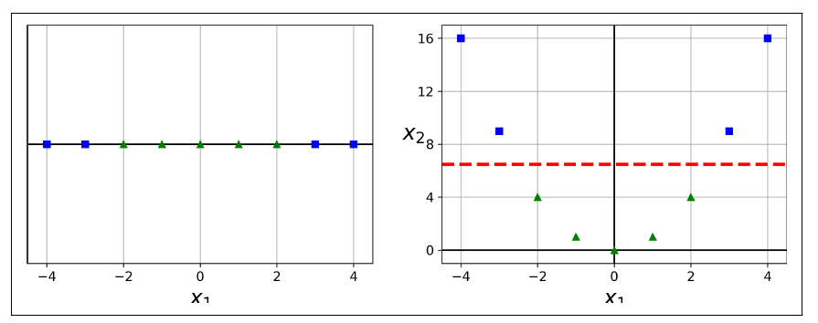
Non-linear SVM
Consider the left plot. You cannot define a single hyperplane (a single point) to separate the red and blue points.
The second plot just squares the same points. Now we see that the dashed red line can linearly separate the classes.
The general idea is to project lower dimensional data to higher dimensions to create a linear separation in higher dimensions.

Slide 8
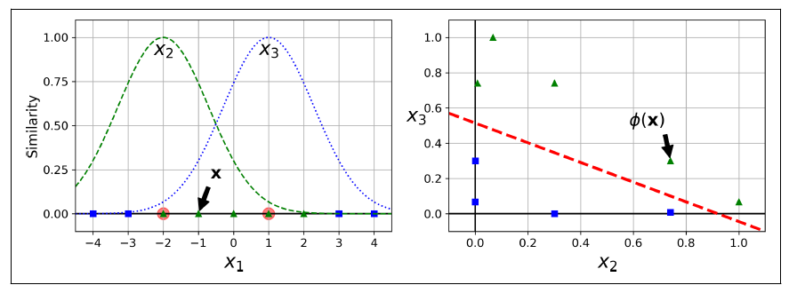



Non-linear SVM
Here’s another way. Consider two points/landmarks at x=-2 and x=1.
We define the Gaussian Radial Basis Function (RBF) as
If we evaluate this at every point for the two landmarks, we get two new features $x_{2}$ and $x_{3}$.
The plot on the right shows that the data is separable in the space of $x_{2}$ and $x_{3}$
In general, such features are generated for every landmark in the dataset resulting in large number of features which increases the chance of linear separability. This is known as the kernel trick. The following is the kernel function for Gaussian RBF.

Slide 9
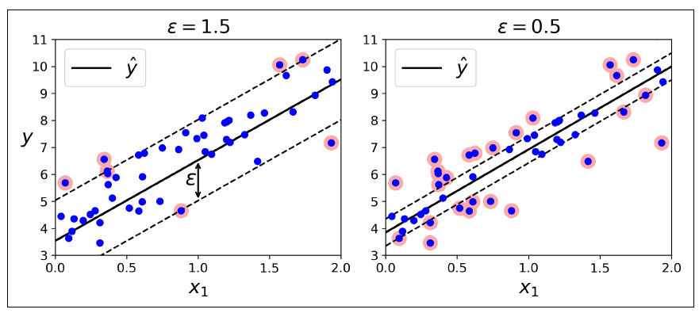
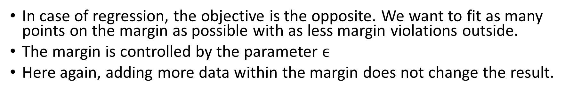
SVM Regression
In case of regression, the objective is the opposite. We want to fit as many points on the margin as possible with as less margin violations outside.
The margin is controlled by the parameter $ϵ$
Here again, adding more data within the margin does not change the result.

Slide 10
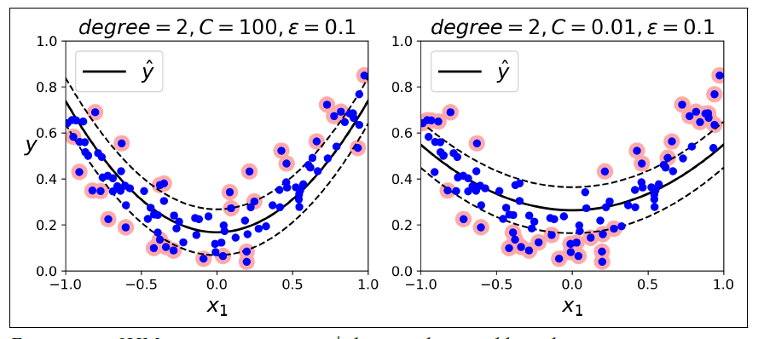
SVM Non-Linear Regression
We can apply the kernel trick in regression too.

